Slide 1
Unit – 2
Programming of PLC

Slide 2
Contents
Fundamentals of logic
Program scan
Relay logic
PLC programming languages
Functional block – timers, counters, math instructions, data manipulation instructions
Requirement of communication networks for PLC
PLC to PC communication to computer

Slide 3
Fundamentals of logic
The PLC, like all digital equipment, operates on the binary principle.
The term binary principle refers to the idea that many things can be thought of as existing in only one of two states.
These states are 1 and 0. The 1 and 0 can represent ON or OFF, open or closed, true or false, high or low, or any other two conditions.
The key to the speed and accuracy with which binary information can be processed is that there are only two states, each of which is distinctly different.
There is no in-between state so when information is processed the outcome is either yes or no.

Slide 4

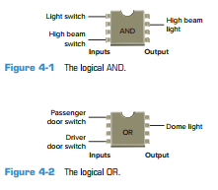



Slide 5
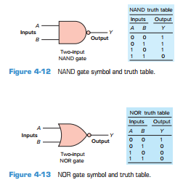
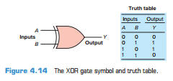

Slide 6
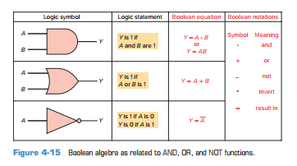

Slide 7
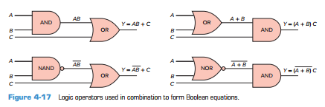

Slide 8
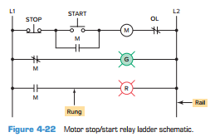
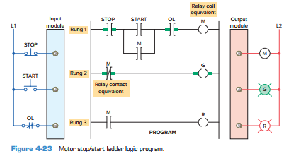
Hardwired Logic versus Programmed Logic

Slide 9
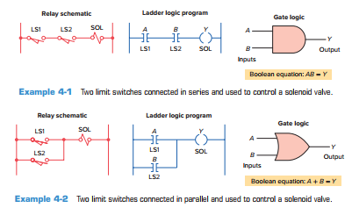

Slide 10
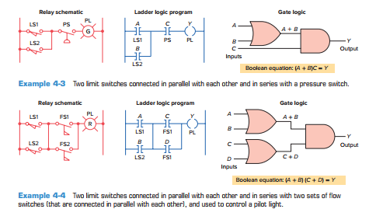

Slide 11
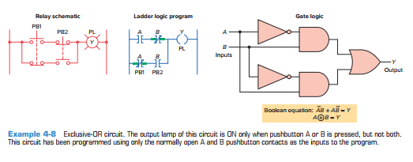

Slide 12
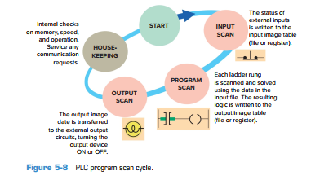
Program Scan
When a PLC executes a program, it must know—in real time—when external devices controlling a process are changing.
During each operating cycle, the processor reads all the inputs, takes these values, and energizes or deenergizes the outputs according to the user program.
This process is known as a program scan cycle.

Slide 13
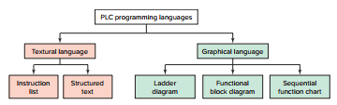
PLC Programming Languages

Slide 14
Ladder Diagram (LD)—a symbolic depiction of instructions arranged in rungs similar to ladderformatted schematic diagrams.
Function Block Diagram (FBD)—a graphical depiction of process ﬂow using simple and complex interconnecting blocks. (also called as Graph Chart)
Sequential Function Chart (SFC)—a graphical depiction of interconnecting steps, actions, and transitions.
Instruction List (IL)—a low-level, text-based language that uses mnemonic instructions.
Structured Text (ST)—a high-level, text-based language such as BASIC, C, or PASCAL specifically developed for industrial control applications.

Slide 15
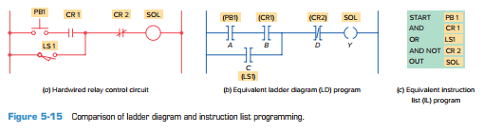

Slide 16
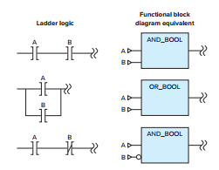
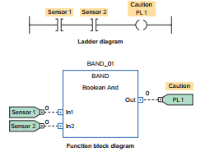
Functional block Diagram

Slide 17
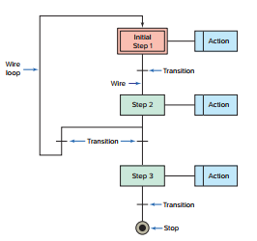
Sequential Functional Chart

Slide 18
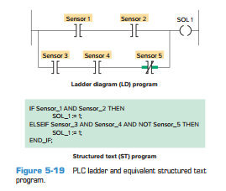
Structured Text

Slide 19
Example
A temperature control system consists of four thermostats controlling three heating units.
The thermostat contacts are set to close at 50°, 60°, 70°, and 80°F, respectively.
The PLC ladder logic program is to be designed so that at a temperature below 50°F, three heaters are to be ON.
From 50° to 60°F, two heaters are to be ON. For 60° to 70°F, one heater is to be ON.
Above 80°F, there is a safety shutoff for all three heaters in case one stays on because of a malfunction.
A master switch is to be used to turn the system ON and OFF. Prepare a typical PLC program for this control process.

Slide 20
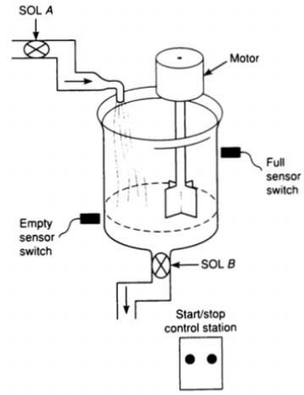

Slide 21
Timers
In general, there are three different PLC timer types: the on-delay timer (TON), off-delay timer (TOF), and retentive timer on (RTO). These timer commands can be summarized as follows: TON (Timer On Delay)—Counts time-based intervals when the instruction is true. TOF (Timer Off Delay)—Counts time-based intervals when the instruction transitions from a true to false condition. RTO (Retentive Timer On)—Counts time-based intervals when the instruction is true and retains the accumulated value when the instruction goes false or when power cycle occurs. RES (Reset)—Resets a retentive timer’s accumulated value to zero

Slide 22
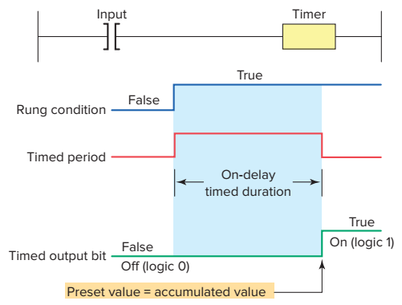
On Delay Timer

Slide 23
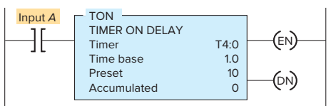
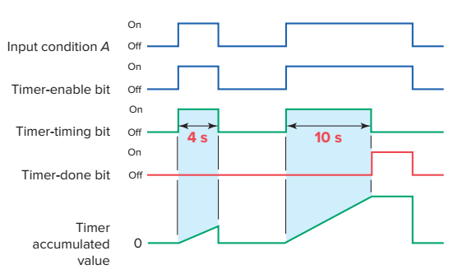

Slide 24
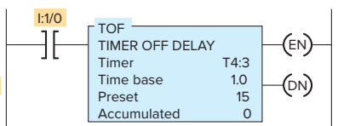
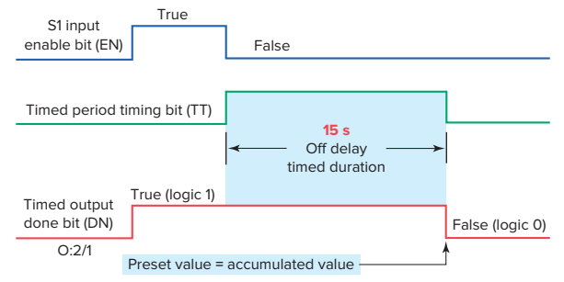
Off- Delay Timer

Slide 25
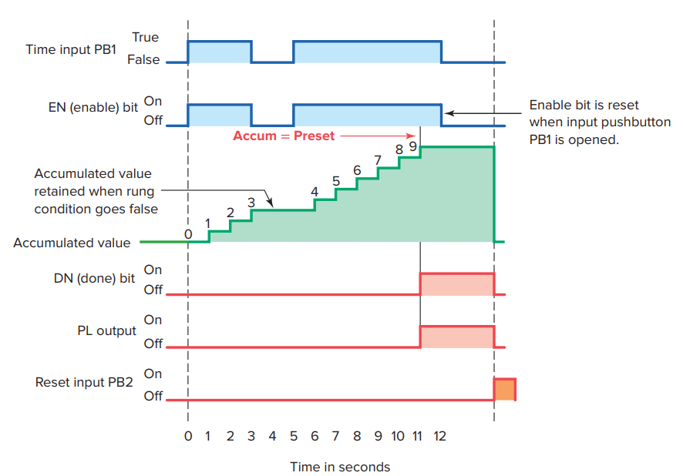
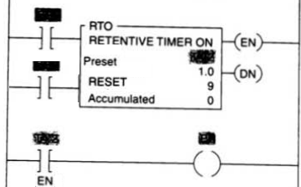
Retentive Timer

Slide 26
Example
The operation of the program can be summarized as follows:
To start the machine, the operator turns SW on.
Before the motor shaft starts to turn, the bearings are supplied with oil by the pump for 10 seconds. The bearings also receive oil when the machine is running.
When the operator turns SW off to stop the machine, the oil pump continues to supply oil for 15 s.
A retentive timer is used to track the total running time of the pump. When the total running time is 3 hours, the motor is shut down and a pilot light is turned on to indicate that the filter and oil need to be changed.
A reset button is provided to reset the process after the filter and oil have been changed.

Slide 27
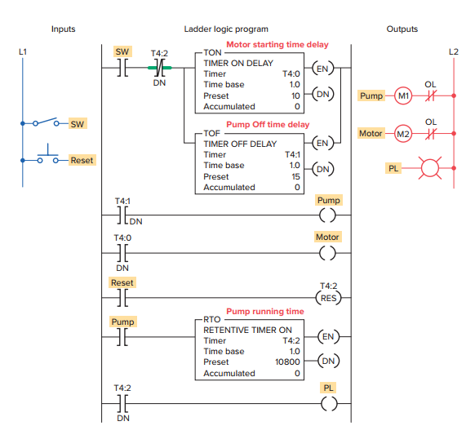

Slide 28
Cascading Timers
The operation of the circuit can be summarized as follows:
Motor starter coil M1 is energized when the momentary start pushbutton PB2 is actuated.
As a result, motor 1 starts, contact M1-1 closes to seal in M1, and timer coil TD1 is energized to begin the first time-delay period.
After the preset time period of 20 s, TD1-1 contact closes to energize motor starter coil M2.
As a result, motor 2 starts and timer coil TD2 is energized to begin the second time-delay period.
After the preset time period of 20 s, TD2-1 contact closes to energize motor starter coil M3, and so motor 3 starts.

Slide 29
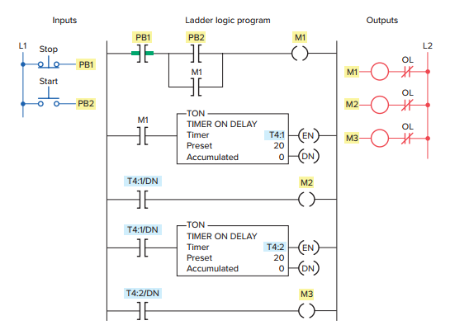

Slide 31
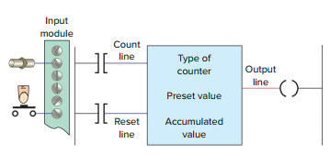
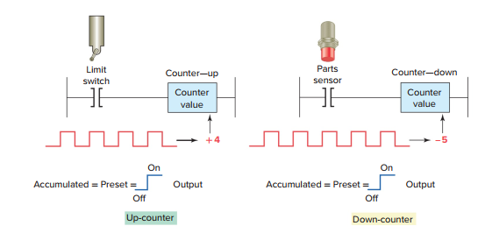
Counters

Slide 32
Up-Counter
The up-counter is an output instruction whose function is to increment its accumulated value on false-to-true transitions of its instruction.
It thus can be used to count false-to-true transitions of an input instruction and then trigger an event after a required number of counts or transitions.
The up-counter output instruction will increment by 1 each time the counted event occurs.

Slide 33
Example
The operation of the program can be summarized as follows:
Operating pushbutton PB1 provides the off-to-on transition pulses that are counted by the counter.
The preset value of the counter is set for 7 Each false-to-true transition of rung 1 increases the counter’s accumulated value by 1.
Output O:2/1 is energized as long as the accumulated value is less than 7.
After 7 pulses, or counts, when the preset counter value equals the accumulated counter value, output DN is energized.
As a result, rung 2 becomes true and energizes output O:2/0 to switch the red pilot light on.
At the same time, rung 3 becomes false and deenergizes output O:2/1 to switch the green pilot light off.
The counter is reset by closing pushbutton PB2, which makes rung 4 true and resets the accumulated count to zero.
Counting can resume when rung 4 goes false again.

Slide 34
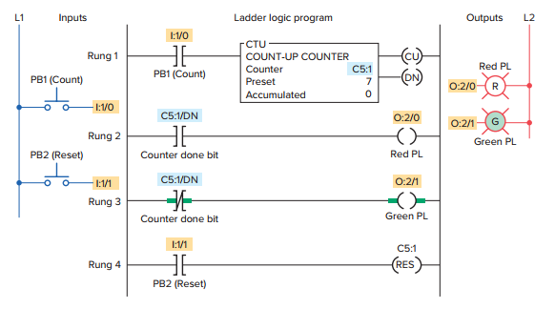

Slide 35
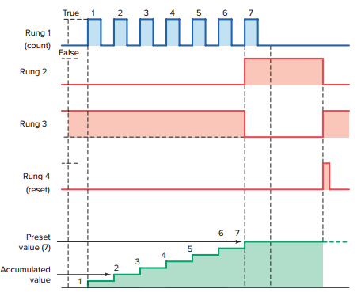

Slide 36
Example
A PLC counter program used to stop a motor from running after 10 operations. The operation of the program can be summarized as follows:
Up-counter C5:0 counts the number of on/off times the motor starts.
The preset value of the counter is set to 10
A counter done bit examine-off instruction is programmed in series with the motor output instruction.
A motor output examine-on instruction is used to increment the accumulated value of the counter for each off/on operation.
After the count of 10 is reached the counter done bit examine-off instruction goes false preventing the motor from being started.
Closure of the reset pushbutton resets the accumulated count to zero.

Slide 37
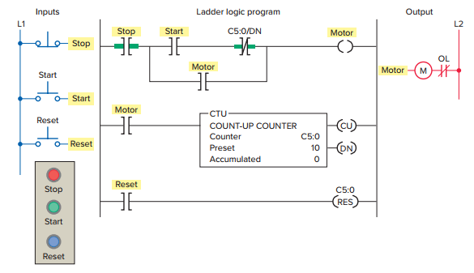

Slide 38
Down-Counter
The down-counter instruction will count down or decrement by 1 each time the counted event occurs. Each time the down-count event occurs, the accumulated value is decremented. Normally the down-counter is used in conjunction with the up-counter to form an up/ down-counter.

Slide 39
The program of contains a count-down counter instruction, the operation of which can be summarized as follows:
With the program in the state shown, the CTD done bit will be set (1) and output 0:2/0 will be energized because the accumulated value of 4 is greater than the preset value of 2.
When the CTD instruction rung makes a false-to-true transition, the accumulated value decreases by one count to 3.
When the input rung condition makes another false-to-true transition, the accumulated value will decrease to 2.
When the input makes one more false-to true transition, the accumulated value will drop to 1.
At this point the accumulated value of 1 is less than the preset value of 2 so the done bit will be reset (0) de-energizing output O:2/0

Slide 40
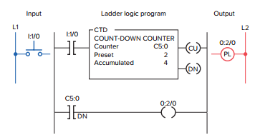

Slide 41
Example
The operation of the program can be summarized as follows:
As a car enters, the enter switch triggers the upcounter output instruction and increments the accumulated count by 1.
As a car leaves, the exit switch triggers the downcounter output instruction and decrements the accumulated count by 1.
Because both the up- and down-counters have the same address, C5:1, the accumulated value will be the same in both instructions as well as the preset.
Whenever the accumulated value of 150 equals the preset value of 150, the counter output is energized by the done bit to light up the Lot Full sign.
A reset button has been provided to reset the accumulated count.

Slide 42
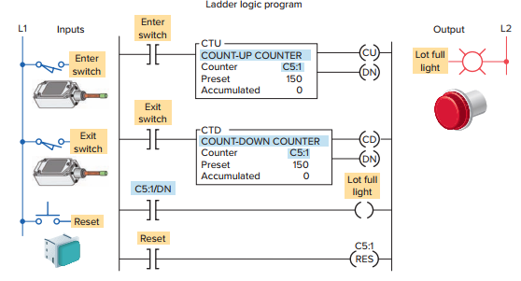

Slide 43
Up – Down Counter
The operation of the program can be summarized as follows:
When the CTU instruction is true, C5:2/CU will be true, causing output A to be true.
When the CTD instruction is true, C5:2/CD will be true, causing output B to be true.
When the accumulated value is greater than or equal to the preset value, C5:2/DN will be true, causing output C to be true.
Input C going true will cause both counter instructions to reset. When reset by the RES instruction, the accumulated value will be reset to 0 and the done bit will be reset.

Slide 44
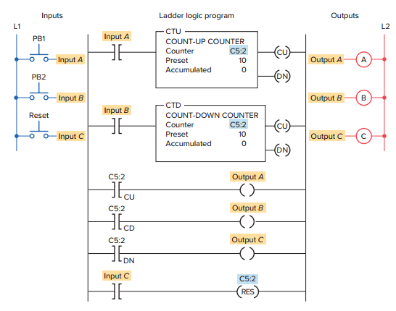

Slide 45
Assignment:
24-hour clock program.

Slide 46
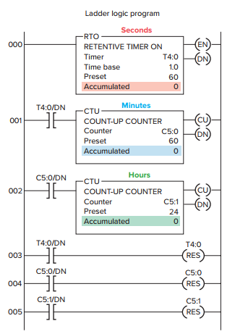

Slide 47
High-Speed Counters
The maximum counting frequency of a traditional PLC’s counter is limited by the scan time of the processor. When the frequency of the input signal is higher than that of the scan time, it is necessary to utilize a high-speed counter (HSC), to avoid errors.

Slide 48
Data manipulation instructions allow numerical data stored in the controller’s memory to be operated on within the control program. It includes operations involving moving or transferring numeric information stored in one memory word location to another word in a different location, and carrying out simple operations such as converting from one data format to another.
The commands can be summarized as follows:
MOV (Move)—Moves the source value to the destination.
MVM (Masked Move)—Moves data from a source location to a selected portion of the destination.
AND (And)—Performs a bitwise AND operation.
OR (Or)—Performs a bitwise OR operation.
XOR (Exclusive Or)—Performs a bitwise XOR operation.
NOT (Not)—Performs a bitwise NOT operation.
CLR (Clear)—Sets all bits of a word to zero.

Slide 49
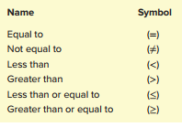
Data Compare Instructions
Data transfer operations are all output instructions, whereas data compare instructions are input instructions. Data compare instructions are used to compare numerical values. These instructions compare the data stored in two or more words (or registers) and make decisions based on the program instructions.

Slide 50
The compare instructions can be summarized as follows:
LIM (Limit test)—Tests whether one value is within the limit range of two other values.
MEQ (Masked Comparison for Equal)—Tests portions of two values to see whether they are equal. Compares 16-bit data of a source address to 16-bit data at a reference address through a mask.
EQU (Equal)—Tests whether the value of Source A is equal to the value of Source B.
NEQ (Not Equal)—Tests whether the value of Source A is not equal to the value of Source B.
LES (Less Than)—Tests whether the value of Source A is less than the value of Source B.
GRT (Greater Than)—Tests whether the value of Source A is greater than the value of Source B.
LEQ (Less Than or Equal)—Tests whether the value of Source A is less than or equal to the value of Source B.
GEQ (Greater Than or Equal)—Tests whether the value of Source A is greater than or equal to the value of Source B

Slide 51
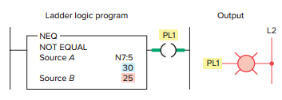
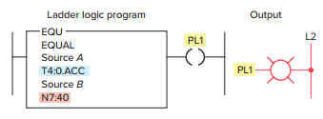
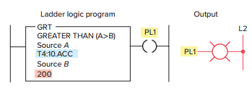
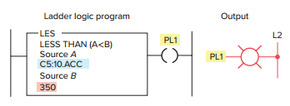
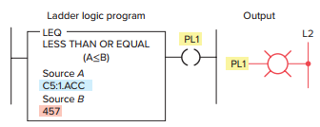
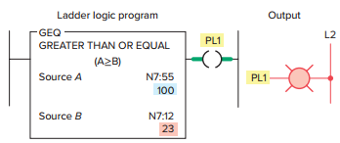

Slide 52
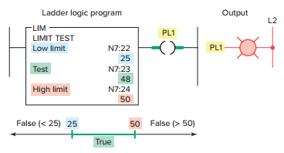
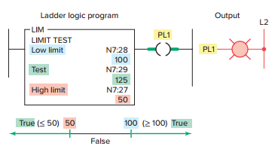

Slide 53
Math Instructions
Math instructions, like data manipulation instructions, enable the programmable controller to take on more of the qualities of a conventional computer. The PLC’s math functions capability allows it to perform arithmetic functions on values stored in memory words or registers.
For example:
Assume you are using a counter to keep track of the number of parts manufactured, and you would like to display how many more parts must be produced in order to reach a certain quota. This display would require the data in the accumulated value of the counter to be subtracted from the quota required. Other applications include combining parts counted, subtracting detected defects, and calculating run rates.

Slide 54
The basic four mathematical functions performed by PLCs are: Addition—The capability to add one piece of data to another. Subtraction—The capability to subtract one piece of data from another. Multiplication—The capability to multiply one piece of data by another. Division—The capability to divide one piece of data by another.

Slide 55
The basic math instructions are ADD, SUB, MUL, and DIV. Each of these instructions has three parameter fields. Namely, Source A, Source B and Destination fields.
The Source A and Source B fields can be an input rack location, file address, instruction field, or a fixed value.
For example: Input Location I:1 File Address N7:5 Instruction Field C5:2.ACC Fixed Value 30
The Destination fields can be an output location, fle address, or an instruction field.
For example: Output location O:2 File Address N7:8 Instruction Field T4:1.PRE

Slide 56
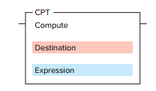
CPT (compute) instruction
When CPT instruction is executed, then copy, arithmetic, logical, or conversion operation residing in the expression field of this instruction is performed and the result is sent to the destination.
The execution time of a CPT instruction is longer than that of a single arithmetic operation and uses more instruction words.
The main advantage of the compute instruction is that it allows you to enter quite complex expressions in one instruction.

Slide 57
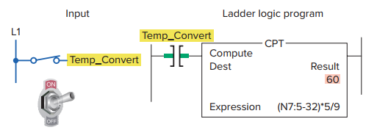
Compute instruction used to convert from Fahrenheit to Celsius

Slide 58
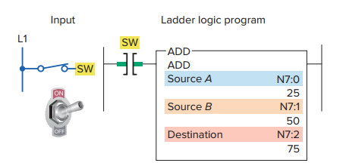
Addition Instruction

Slide 59
Example :
To ADD the accumulated counts of two up-counters. This application requires a pilot light to come on when the sum of the counts from the two counters is equal to or greater than 350.

Slide 60
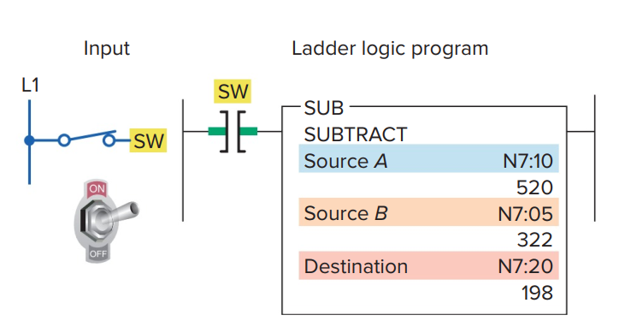
Subtraction Instruction

Slide 61
Example:
To indicate a vessel overfill condition.
This application requires an alarm to sound when a supply system leaks 5 lb or more of raw material into the vessel after a preset weight of 500 lb has been reached.

Slide 62
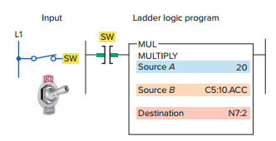
Multiplication Instruction

Slide 63

Example: MUL instruction used to calculate the product of two sources.

Slide 64

Division Instruction

Slide 65

Example:
DIV instruction used to calculate the value that results from dividing source A by source B.

Slide 66
Assignment:
A program to convert Celsius temperature to Fahrenheit and vice versa using math operations.
F = ( 9/5 × C) + 32
C = (F – 32) x 5/9

Slide 67

Direct PC-to-PLC software connection

Slide 68

Serial wiring connection

Slide 69

CONTROL CONFGURATIONS
1. Individual control is used to control a single machine. This type of control does not normally require communication with other controllers .

Slide 70

2. Centralized control is used when several machines or processes are controlled by one central controller. The control layout uses a single, large control system to control many diverse manufacturing processes and operations.

Slide 71

3. distributive control system (DCS) is a network based system. Distributive control involves two or more PLCs communicating with each other to accomplish the complete control task .

Slide 72

Data Communications
Data communications refers to the different ways that PLC microprocessor-based systems talk to each other and to other devices. The two general types of communications links that can be established between the PLC and other devices are point-to-point links and network links.
Point-to-point serial communications link

Slide 73

Local area network (LAN) communication link.

Slide 74

Transmission media.

Slide 75

Supervisory Control and Data Acquisition (SCADA)

